Slide 1
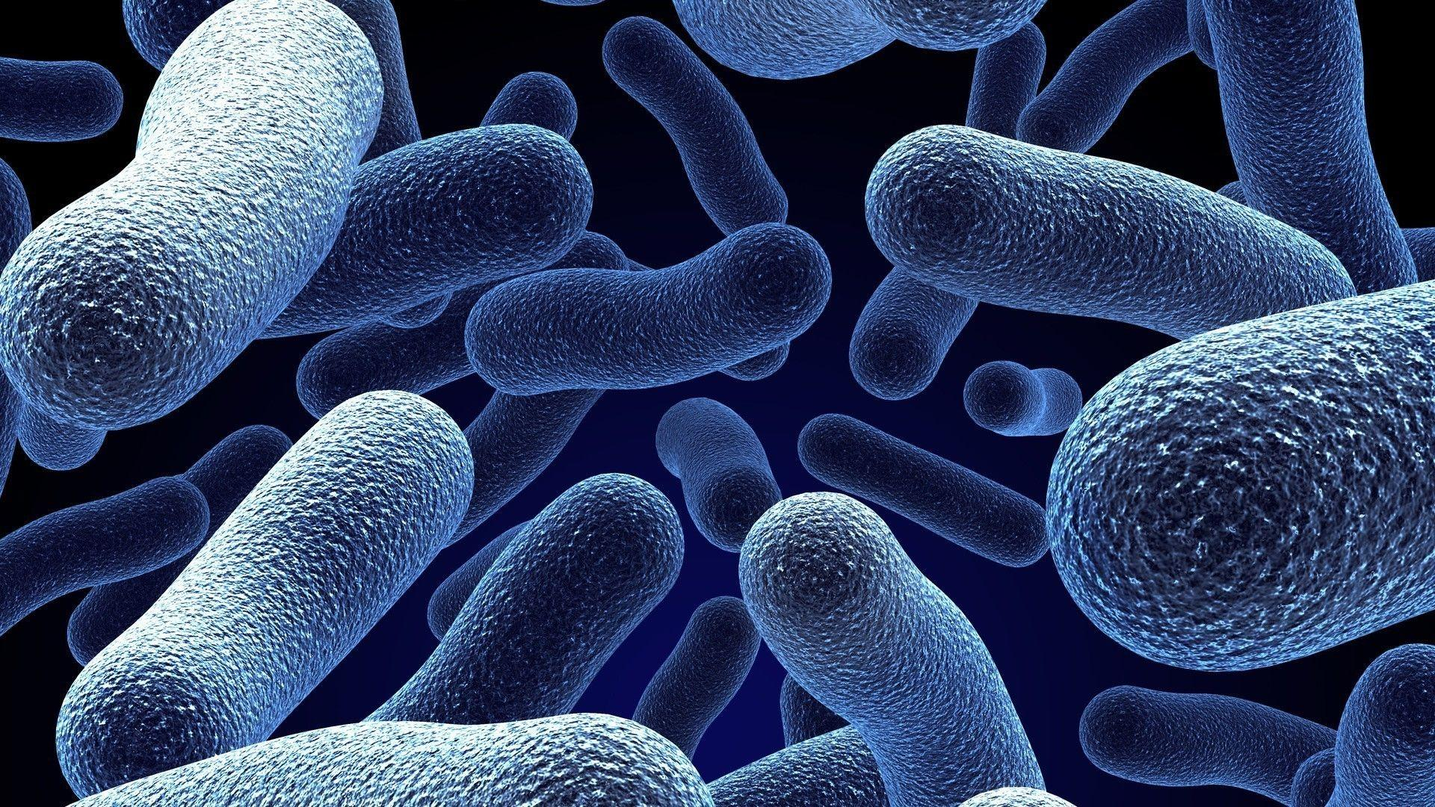
MGMA2024
Bioinformatic Analysis of Microbiome Data
&
Microbiome Data Structure
Hoang Son
Hoangsonltt710@gmail.com
11/7/2024

Slide 2
Bioinformatic Analysis of
Microbiome Data

Slide 3
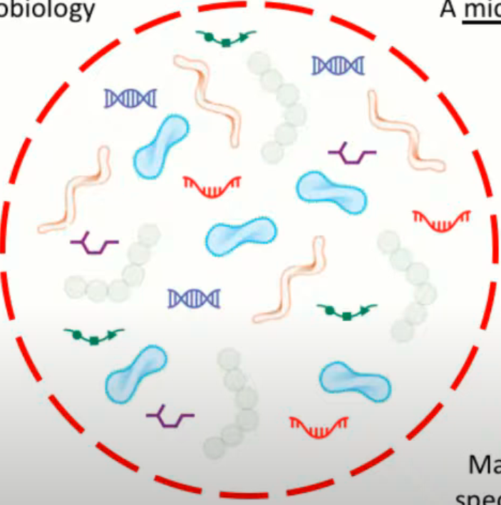
What is a microbiome?
A microbiome is a community in
an environment
The “micro” is from microbiology
Bacteria
Archaea
Fungi
Viruses
Protozoa
Some definitions include community genes and gene products as well (RNAs, proteins, metabolites)

Slide 4
Three main questions for microbiome study
1) Who is there?
2) What are they doing?
3) How are they doing it?
What is the relative proportion of community members?
Bacteria, virus, archaea, etc,…
How rich is the community? How evenly distributed?
What functional chemistry is being carried out?
What environmental products are consumed and what is excreted?
Which enzyme pathways are present?
How is pathway activity stratified within the sample?

Slide 5
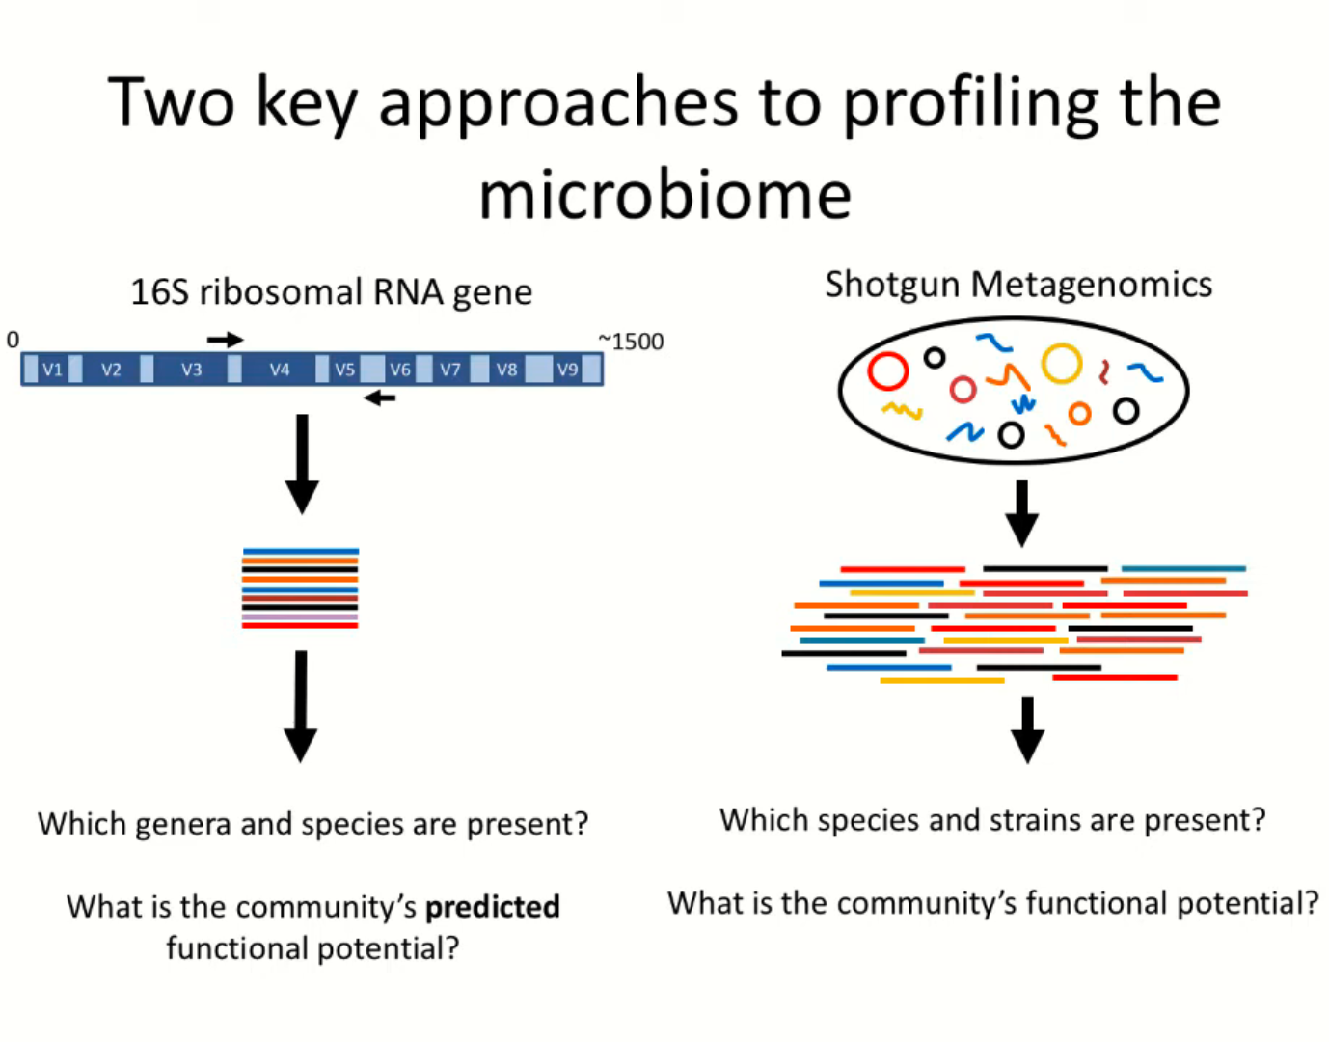

Slide 6
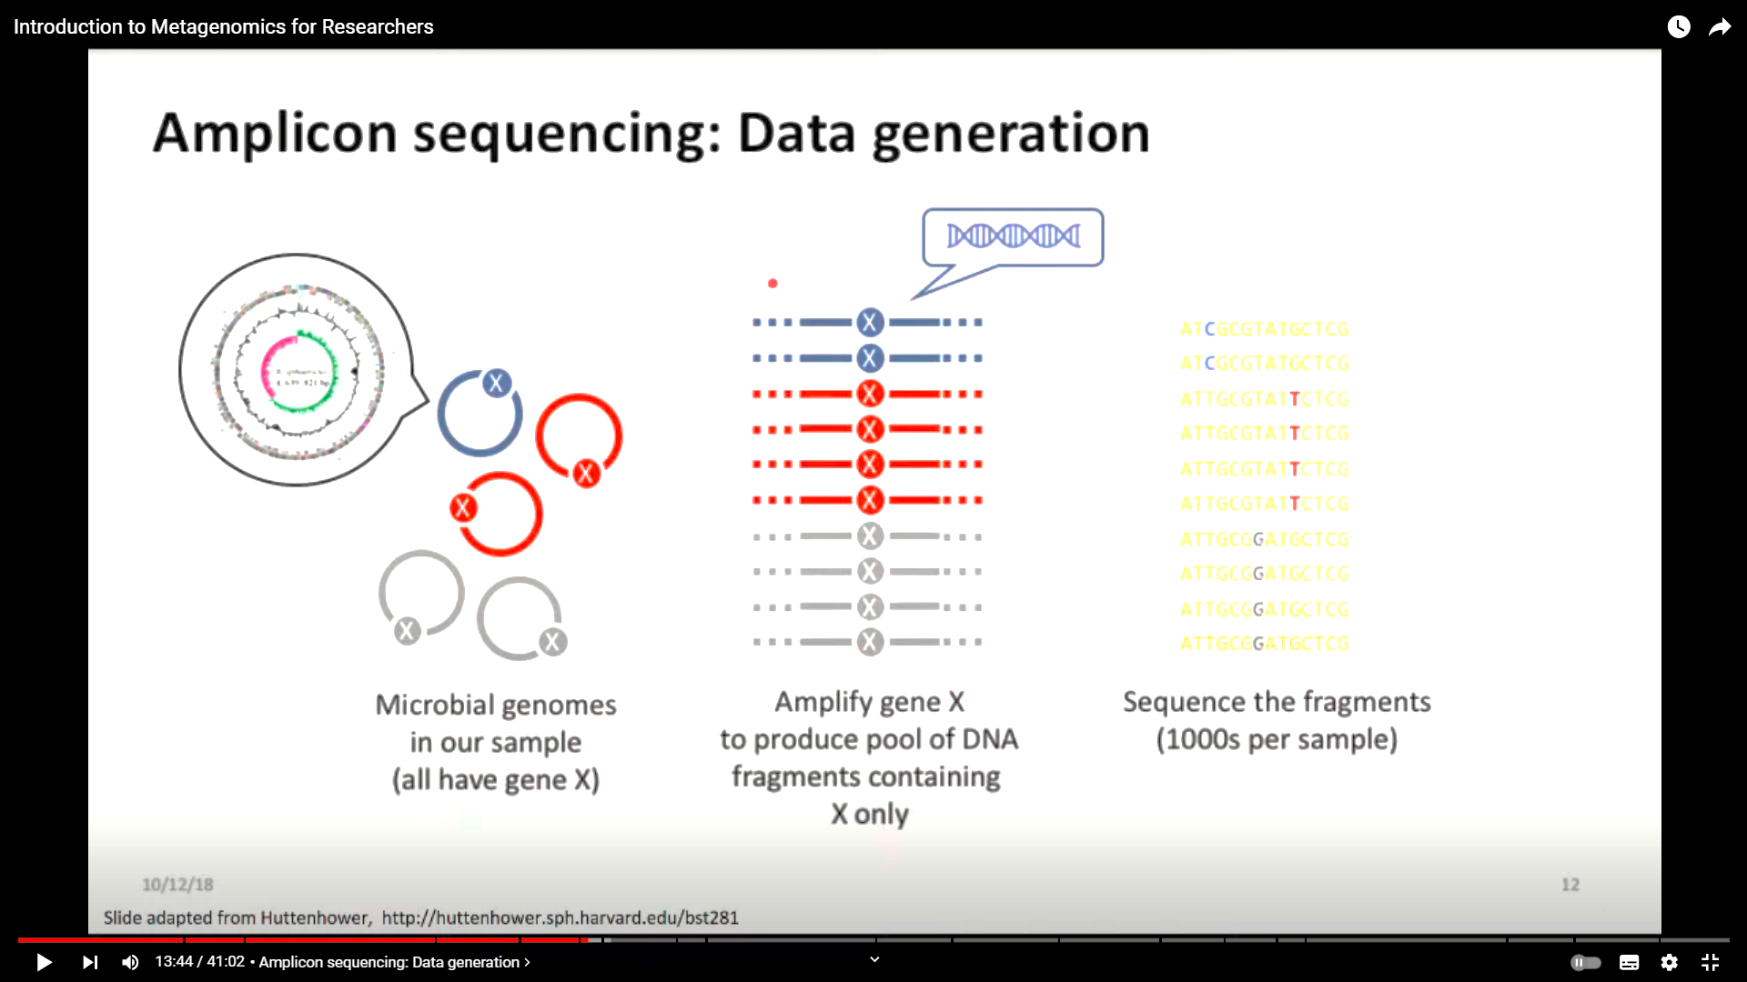
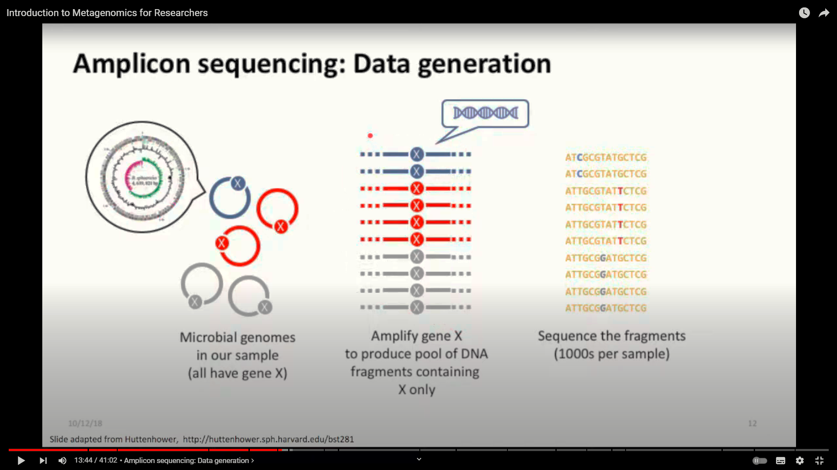
Amplicon sequencing: Data generation
http://hutternhower.sph.havard.edu/bst281

Slide 7
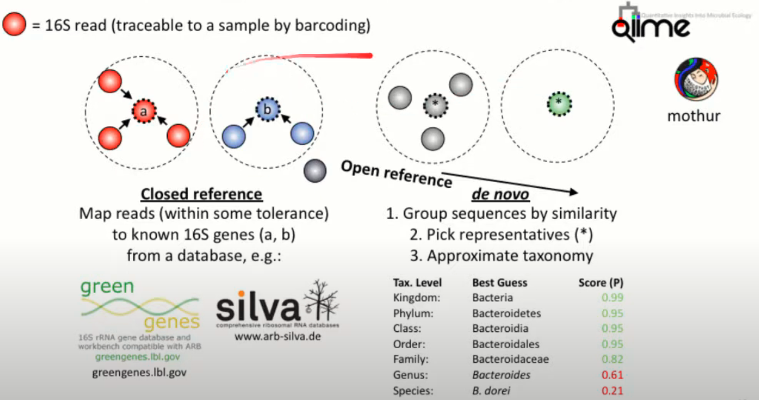
Amplicon/16S sequencing: Data Processing
http://hutternhower.sph.havard.edu/bst281
Notes:
Figure 1. Bioinformatic methods for functional metagenomics.
Studies that aim to define the composition and function of uncultured microbial communities are often referred to collectively as “metagenomic,” although this refers more specifically to particular sequencing-based assays. First, community DNA is extracted from a sample, typically uncultured, containing multiple microbial members. The bacterial taxa present in the community are most frequently defined by amplifying the 16S rRNA gene and sequencing it. Highly similar sequences are grouped into Operational Taxonomic Units (OTUs), which can be compared to 16S databases such as Silva [16], Green Genes [14], and RDP [15] to identify them as precisely as possible. The community can be described in terms of which OTUs are present, their relative abundance, and/or their phylogenetic relationships. An alternate method of identifying community taxa is to directly metagenomically sequence community DNA and compare it to reference genomes or gene catalogs. This is more expensive but provides improved taxonomic resolution and allows observation of single nucleotide polymorphisms (SNPs) and other variant sequences. The functional capabilities of the community can also be determined by comparing the sequences to functional databases (e.g. KEGG [170] or SEED [171]). This allows the community to be described as relative abundances of its genes and pathways. Figure adapted from [172].
https://doi.org/10.1371/journal.pcbi.1002808.g001

Slide 8
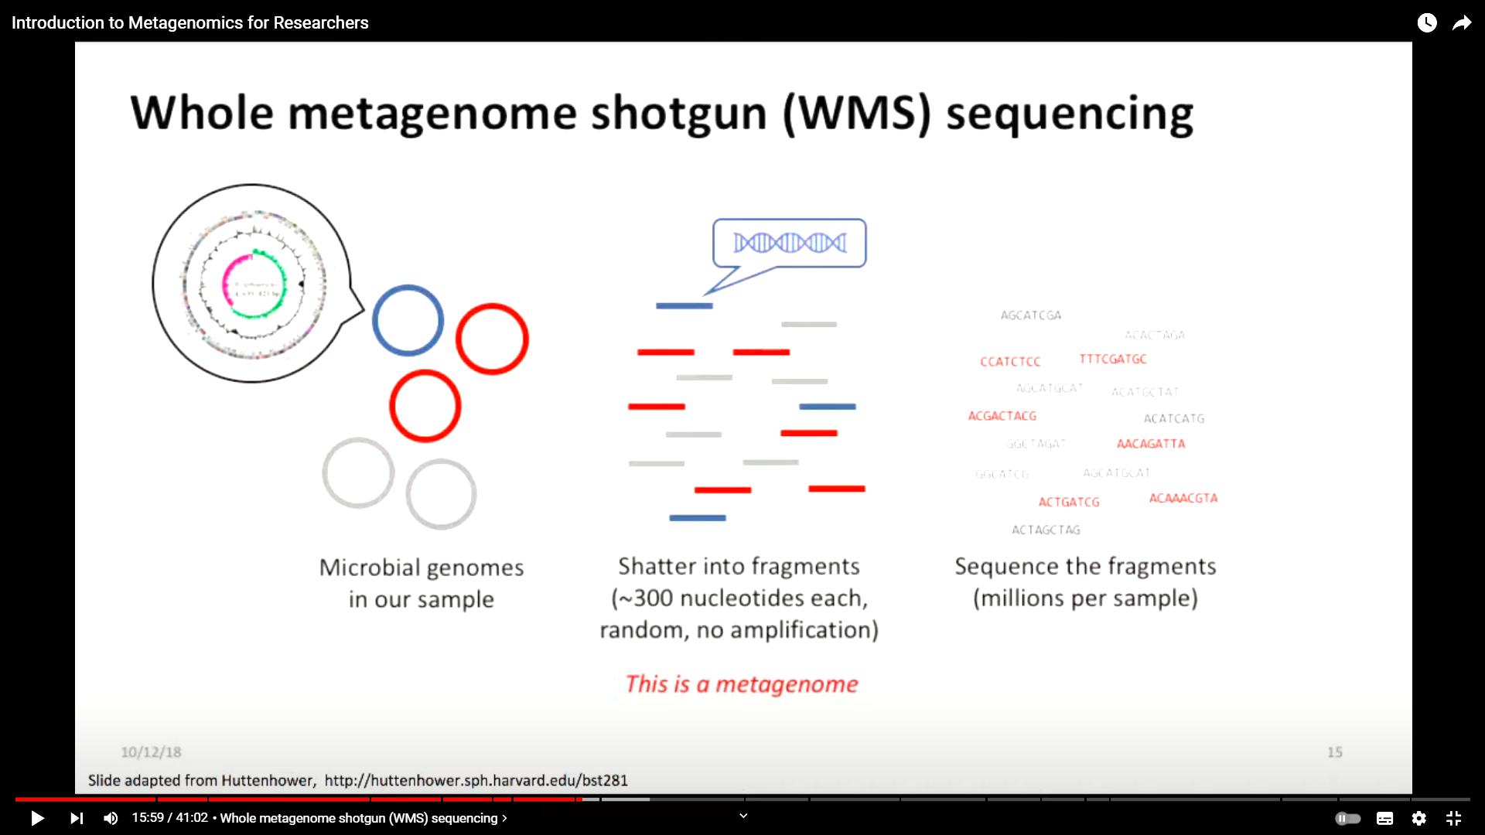
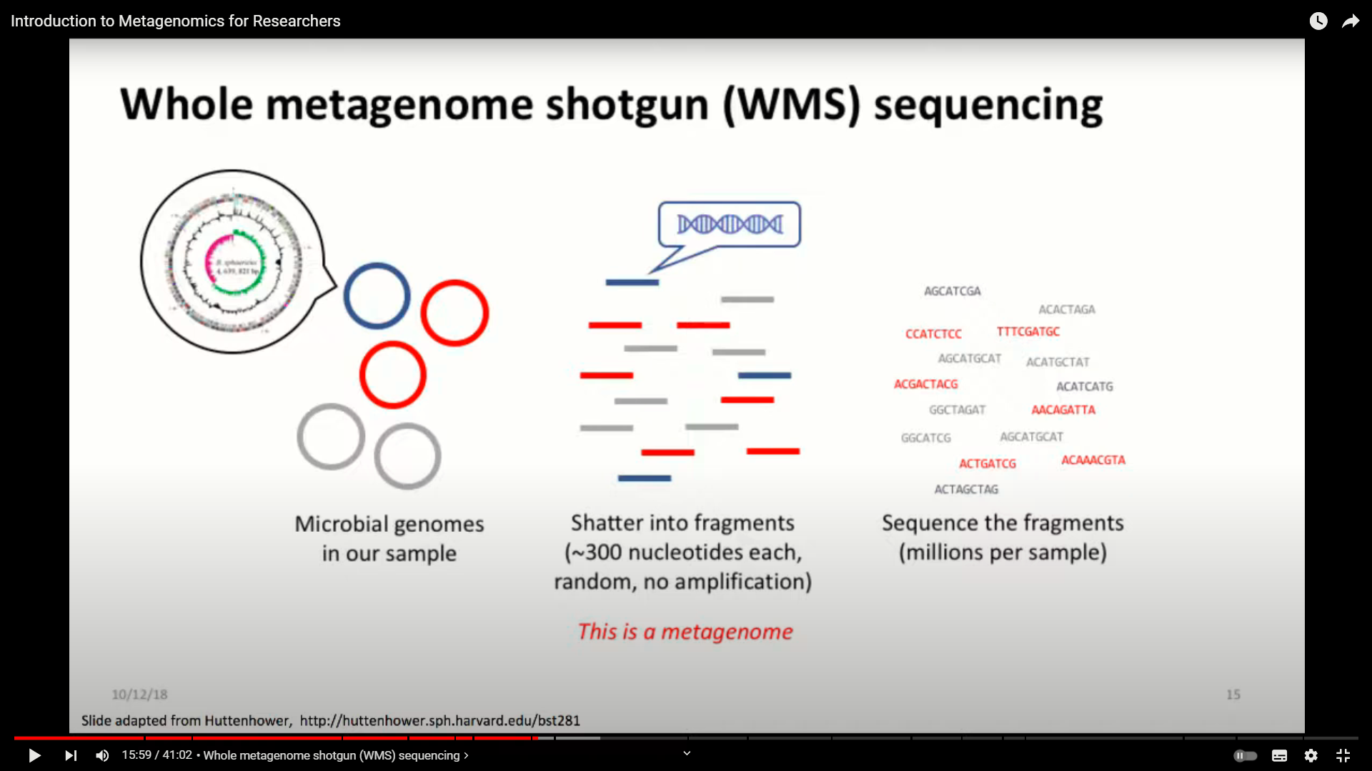
Whole metagenome shotgun (WMS) sequencing

Slide 9
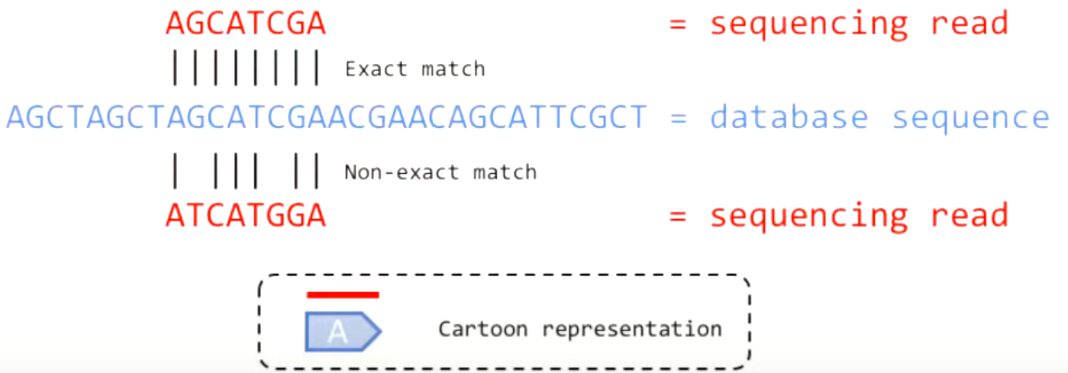
WMS sequencing: Maping-based analysis
Mapping a DNA read/fragment means finding a sequence in a data base (gene, protein or genome) that could be the source of the read/fragment
This is often done by sequence alignment (e.g. BLAST, bowtie2, DIAMOND)
http://hutternhower.sph.havard.edu/bst281

Slide 10
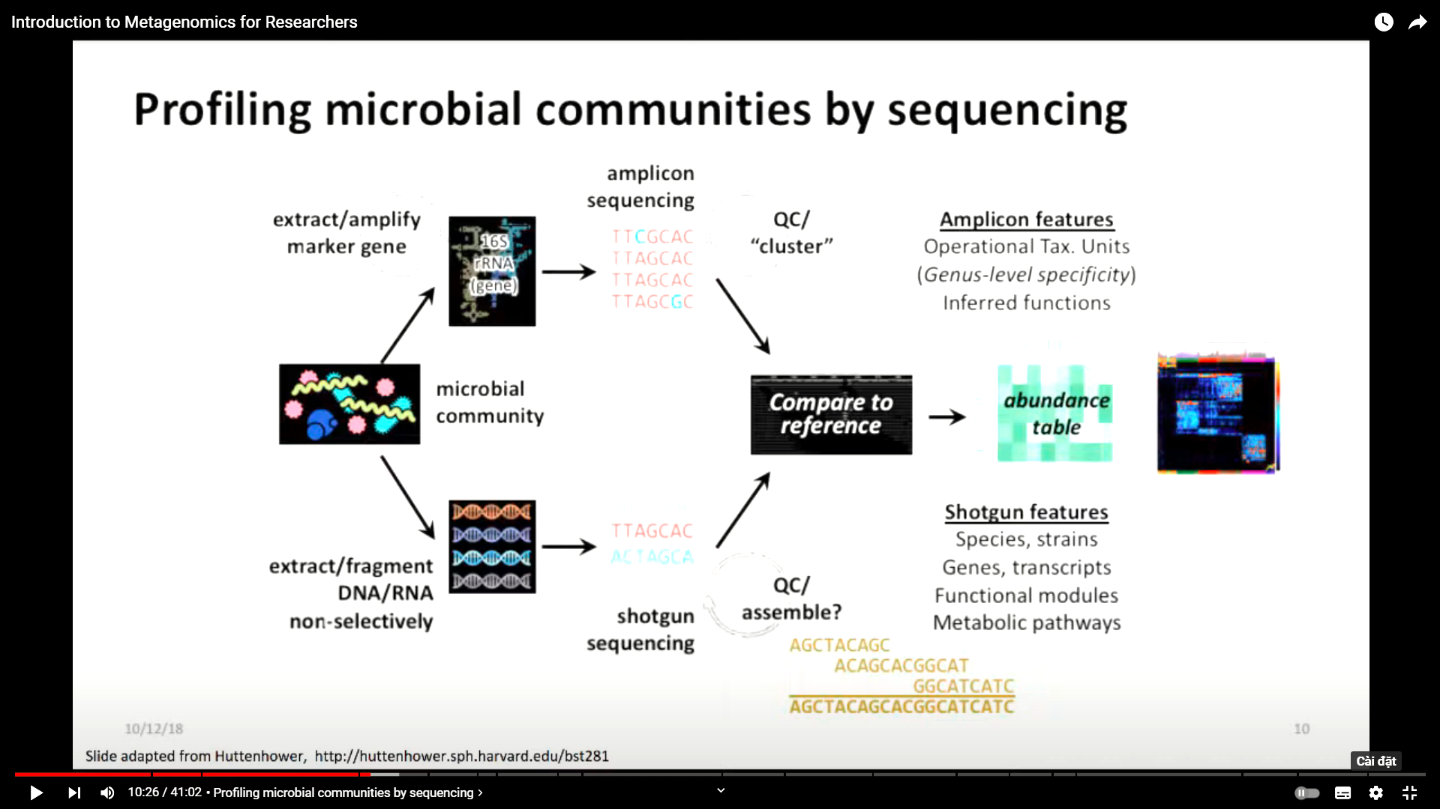
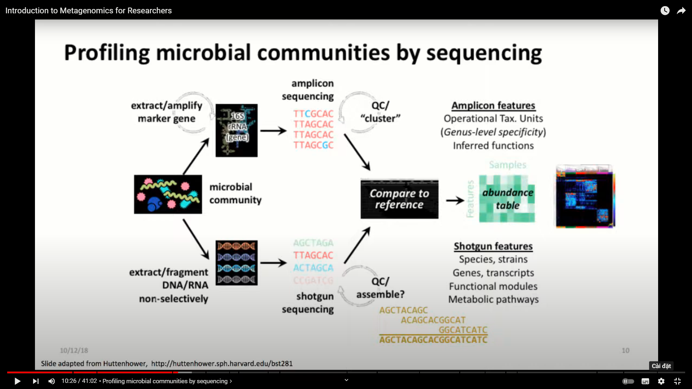
Profiling microbial communities by sequencing
http://hutternhower.sph.havard.edu/bst281

Slide 11
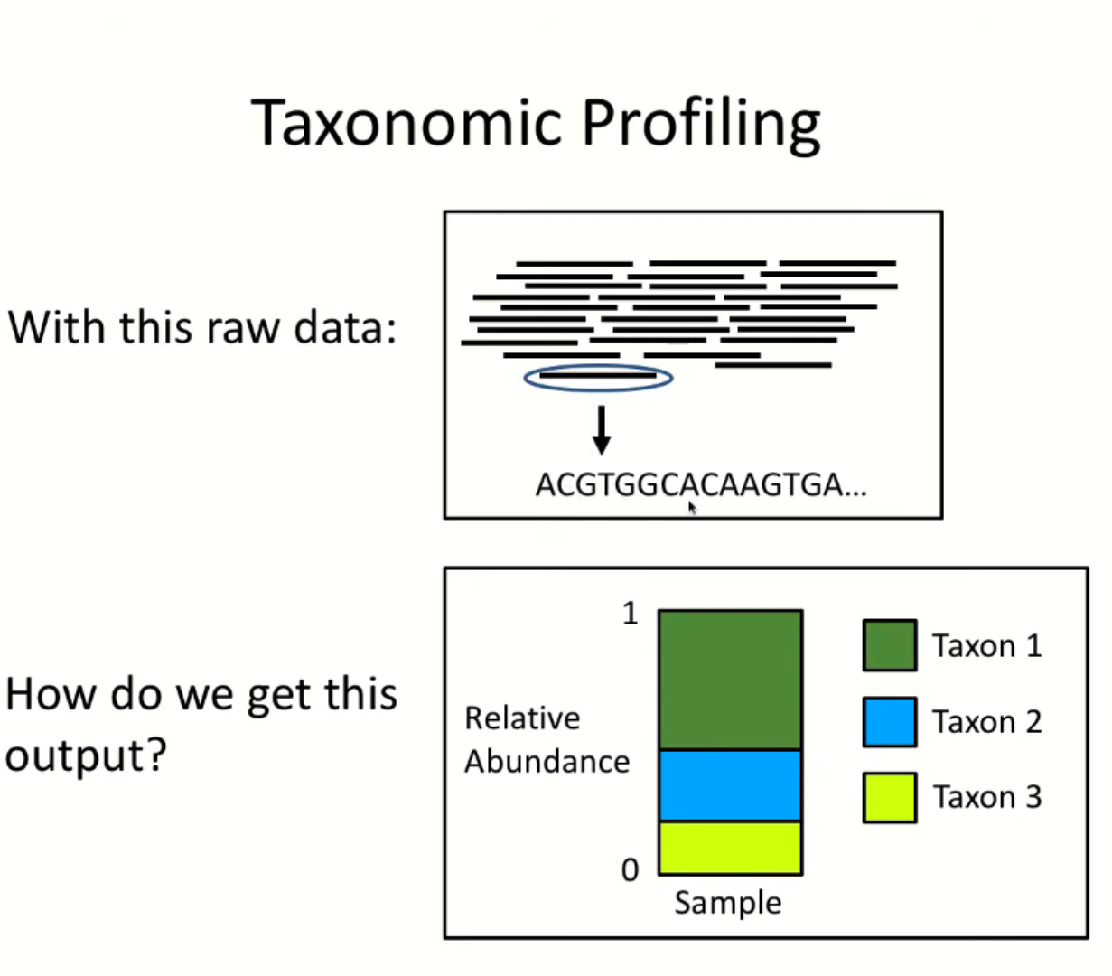

Slide 12
Microbial community analysis of sequencing data
Amplicon/16S rRNA Gene Amplification:
Focus: Identifies the types of bacteria present (Who is there?).
Method: Specific primers target and amplify a specific region of the 16S rRNA gene.
Benefits: Cost-effective, good for community profiling.
Metagenomics:
Focus: Analyzes all DNA in a sample (Who is there? What can they do?).
Method: Sequences all genes present.
Benefits: Provides deeper functional insights into the microbial community.

Slide 13
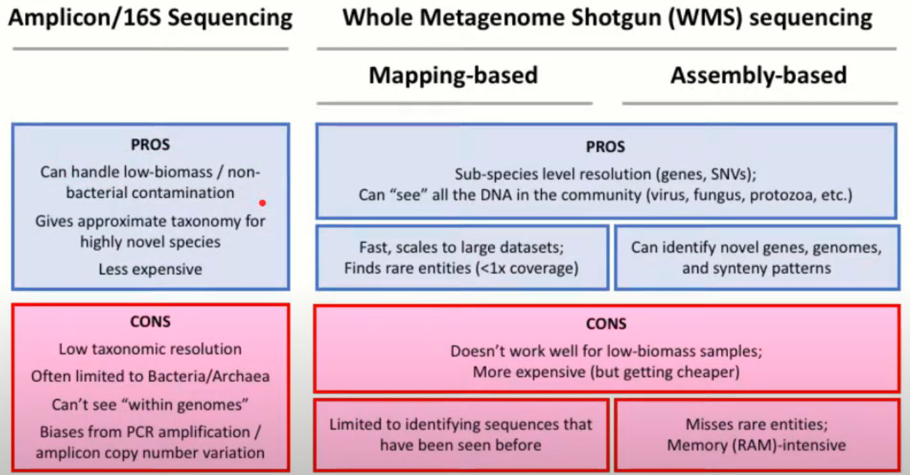
Microbiome seuquencing methods comparison

Slide 14
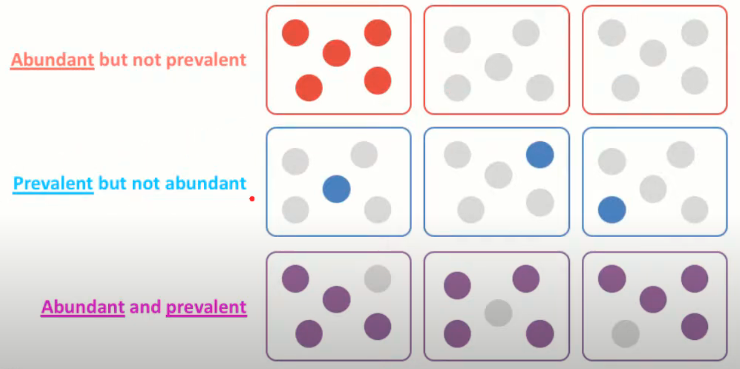
Describing microbiomes: abudance and prevalence

Slide 15
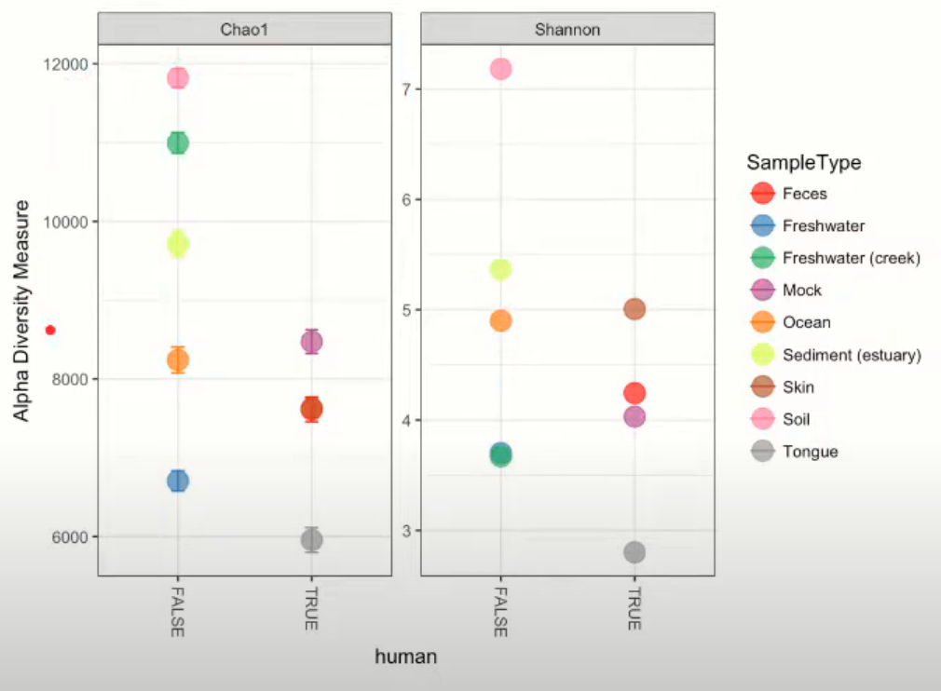
Alpha diversity & Beta diversity
Alpha diversity
Measure of the species richness and sample evenness
Richness: Chao1, Shannon
Eveness: Simpson index
https://drive5.com/usearch/manual/alpha_metrics.html

Slide 16
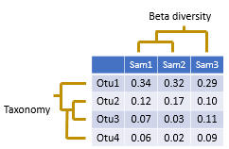
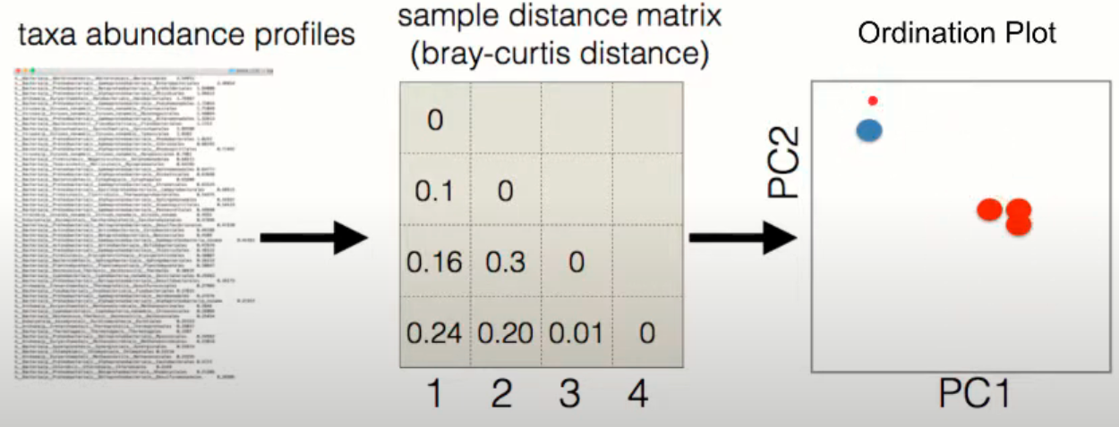
Alpha diversity & Beta diversity
Beta diversity: calculate the between-sample community distance

Slide 17
Microbiome Data Structure

Slide 18
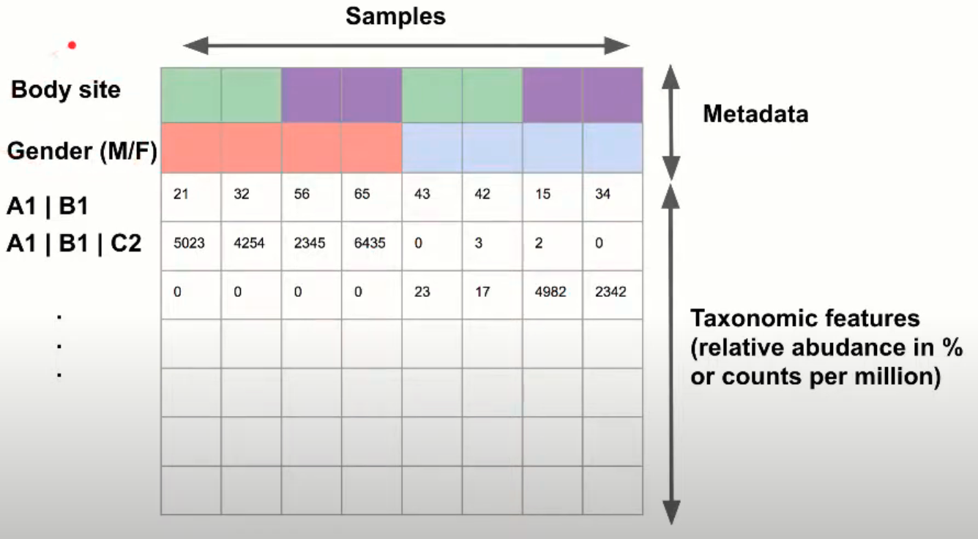
Properties of microbiome data (sparsity, dynamic range)

Slide 19
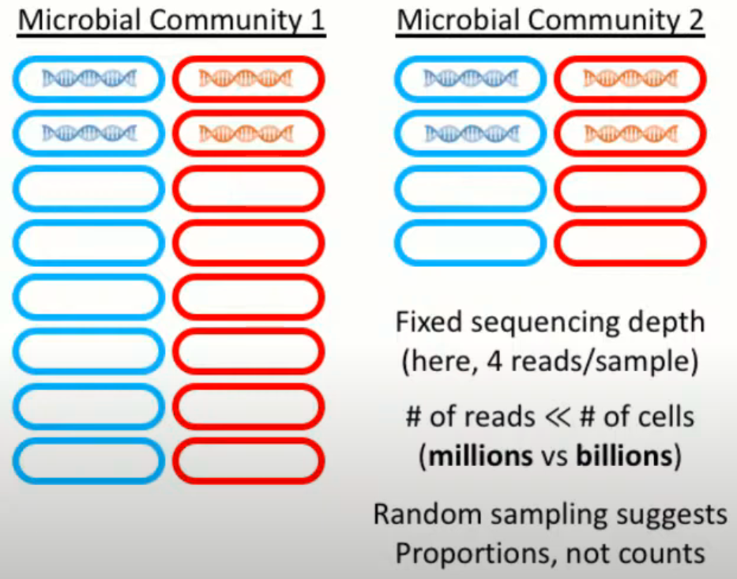
Microbiome data are compositional

Slide 20
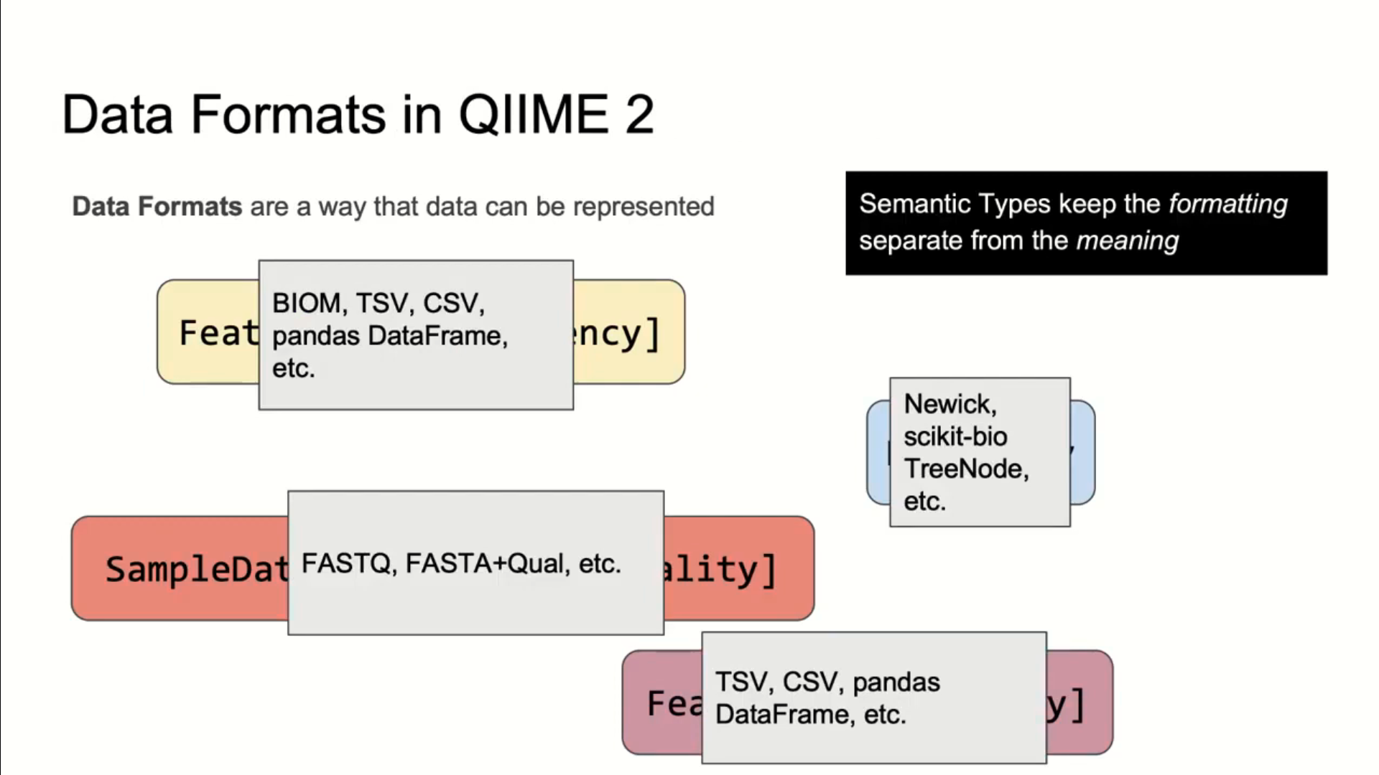
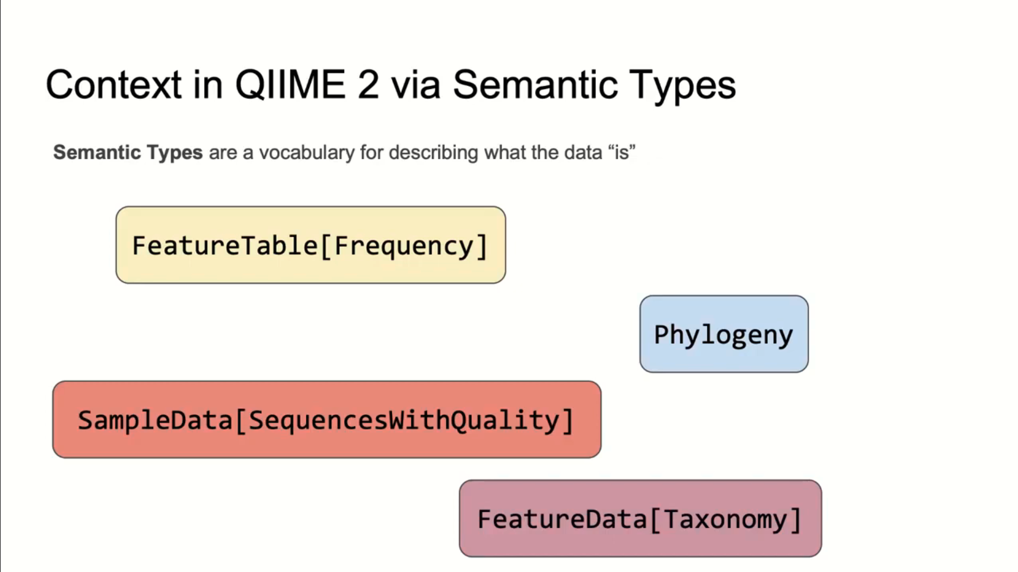

Slide 22
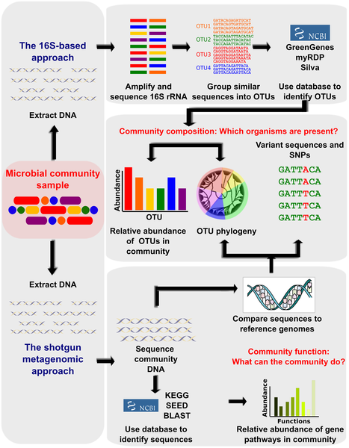
https://journals.plos.org/ploscompbiol/article?id=10.1371/journal.pcbi.1002808

Slide 23
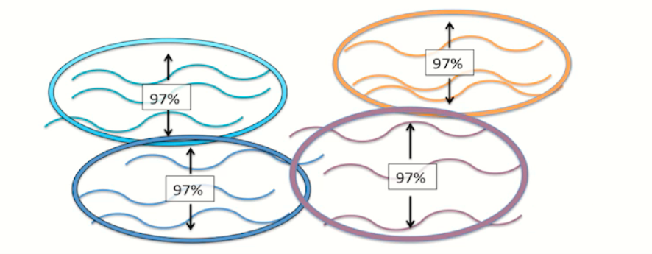
Operational taxonomic units (OTUs)
Operational Definitions for Microbial Classification:
OTUs are functional units used to categorize groups of closely related organisms based on sequence similarity.
They can represent various taxonomic levels, including individual organisms, species, genera, or even higher classifications.

Slide 24
Operational taxonomic units (OTUs)
Clustering by Sequence Similarity:
OTUs are generated by grouping sequences based on their similarity in a specific marker gene, often the 16S ribosomal RNA (rRNA) gene.
The Threshold Factor:
The selection of a sequence similarity threshold is crucial for defining OTUs.
A commonly used threshold is 97% sequence identity, considered to roughly represent the species level in bacteria.
Different thresholds and clustering algorithms can lead to variations in the number and composition of OTUs (95% - genus, 90% - family, 80% phylum)

Slide 25
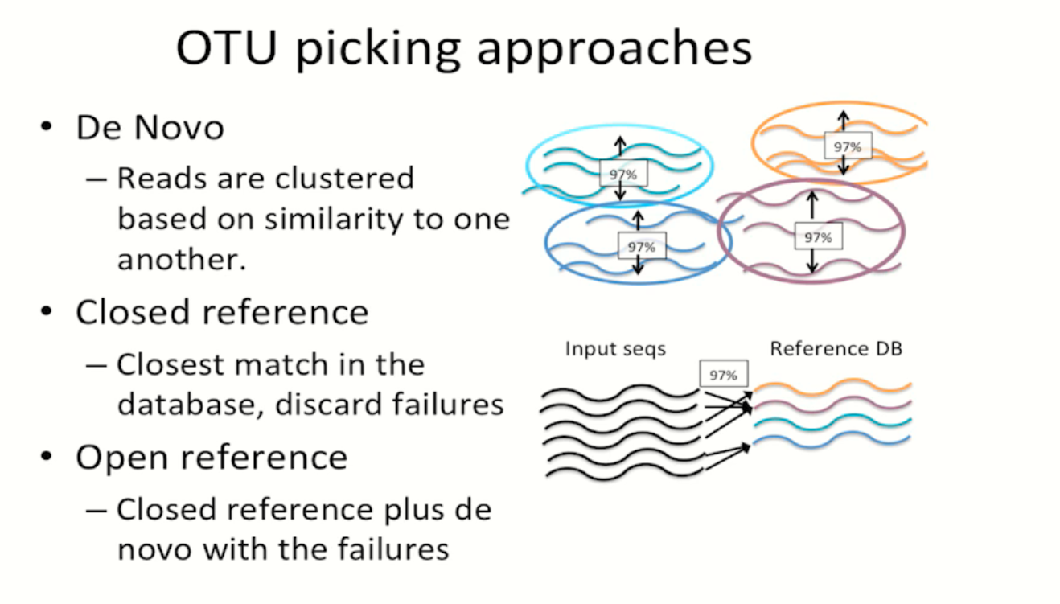

Slide 26
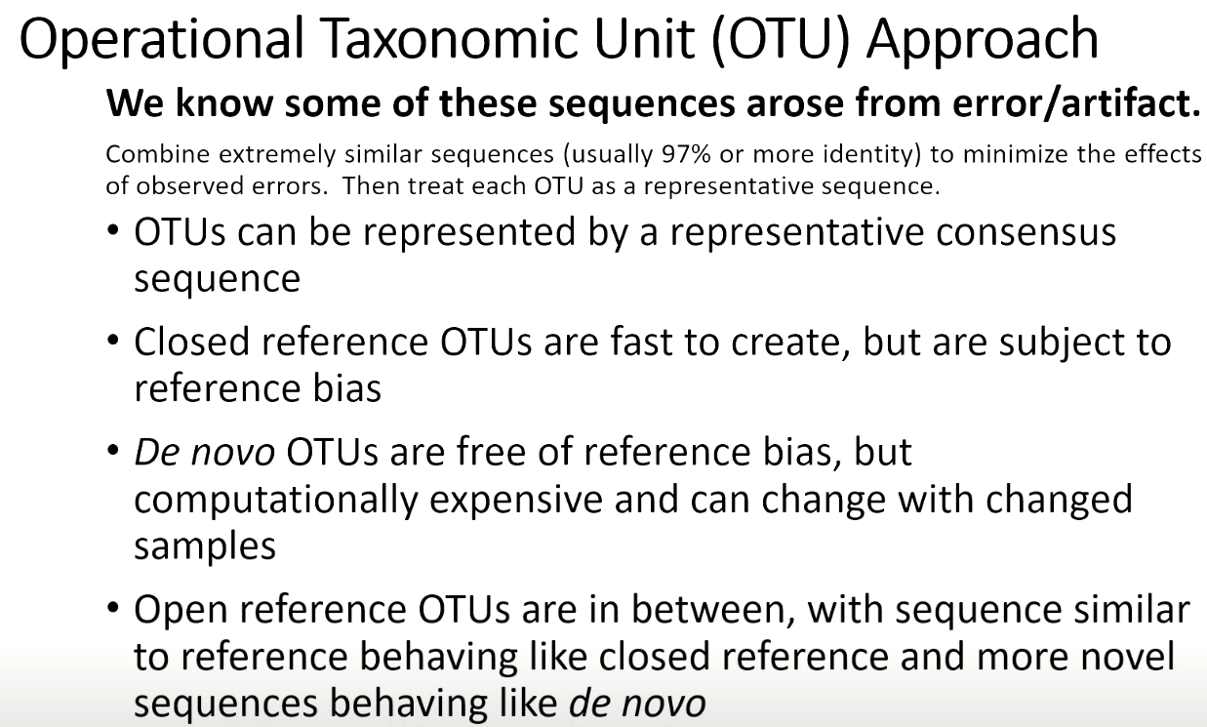

Slide 27
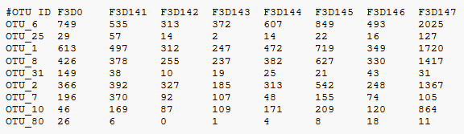
Operational taxonomic units (OTUs)

Slide 28
Gene sequence alignment tools, used for 16S OTU clustering
uclust / usearch
QIIME2 (internally using usearch for 16S OTU clustering)
DADA2 to analyze exact 16S sequence variants (no OTU cluster)
Clustal Omega
CD-HIT

Slide 29
Thank you for listening!

Slide 30
